Slide 1
Micro services - quick bite
Ramesh Maharaddi

Slide 2

The Monolith Application

Slide 3

Software Monolith
One build and deployment unit
One code base
One technology stack (Linux, JVM, Tomcat, Libraries)
Benefits
Simple scaling model for operations
just run multiple copies behind a load balancer

Slide 4


Problems of Software Monoliths
Overloads your IDE and container
Slow down development
Refactoring and builds take hours
Testing in continuous integration takes days
Huge and intimidating code base for developers
Scaling is limited
Running a copy of the whole system is resource-intense
Increase “tight coupling” between components, As codebase increases

Slide 5
Problems of Software Monoliths Cont.…
Re-deploying means halting the whole system
Long Build/Test/Release cycle
Operation is nightmare
Module X is failing who is the owner
New release takes months and long time to add new future

Slide 6
Therefore, Microservices
Definitions of microservices
Microservice architecture - also known as the Microservice - is an architectural style that structures an application as a collection of loosely coupled services, which implement business capabilities
Functional system decomposition into manageable and independently deployable components
Microservice architecture is a method of developing software applications as a suite of independently deployable, small, modular services in which each service runs a unique process and communicates through a well-defined, lightweight mechanism to serve a business goal.

Slide 7
Characteristics of Microservices

Slide 8

Small and focused on doing one thing
Size matters (not)
It’s not about lines of code used
Small enough to be handled by a single team

Slide 9

Autonomous
Is a separate entity
Make changes to service and deploy without changing anything else
Microservices are autonomous services that take full responsibility for one business capability
Full responsibility includes presentation, API, data storage and business logic.

Slide 10
Key Benefits
Technology Heterogeneity
Resilience
Scaling
Ease of development
Easy to scale
Rapid Build/Test/Release cycle
Clear ownership and accountability
New release takes minute and short time to add new future

Slide 11
Yelp, Airbnb, Stripe and Netflix.
http://www.kennybastani.com/2015/07/spring-cloud-docker-microservices.html
http://bits-and-kites.blogspot.in/2014/10/spring-cloud-eureka-server.html
http://wildfly-swarm.io/generator/
https://technologyconversations.com/2015/09/08/service-discovery-zookeeper-vs-etcd-vs-consul/
https://dzone.com/articles/service-discovery-in-a-microservices-architecture-1
http://www.baeldung.com/spring-cloud-netflix-eureka
https://dzone.com/articles/spring-cloud-netflix-load-balancer-with-ribbonfeig
https://fernandoabcampos.wordpress.com/category/enableeurekaserver/
https://www.nginx.com/blog/microservices-api-gateways-part-1-why-an-api-gateway/

Slide 12
Basic characteristic of micro services
Service registration and Service discovery
Client side load balancing
Circuit Breaker
Centralized configuration
API Gateways
Servicing Tracing

Slide 13
Frameworks to build micro services
Frameworks
Spring Boot
wildfly swarm
WSO2
bootique
Dropwizard
Play
Django
There are many framework to build the micro services

Slide 14
Service registration and Service discovery
What is Service discovery?
Service discovery is the automatic detection of services. In order to make a request, your code needs to know the network location (IP address and port) of a service instance.
Why Use Service Discovery
In a traditional application running on physical hardware, the network locations of service instances are relatively static(IP, Port)
In a modern, cloud-based application, this is a much more difficult to find the service instances which have dynamically assigned network locations.
Service instances changes dynamically because of auto-scaling, failures, and upgrades
There are two main service discovery patterns
client-side discovery(Ribbon)
server-side discovery(amazon elastic load balancing, haproxy and apache http server)

Slide 15
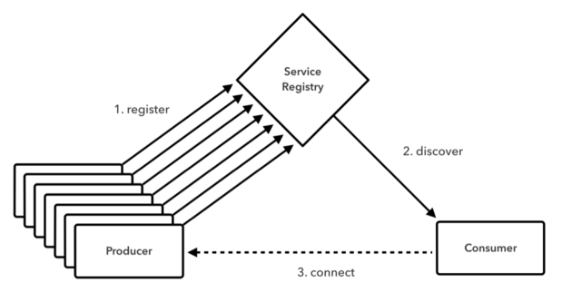
Service registration and Service discovery Cont.…

Slide 16
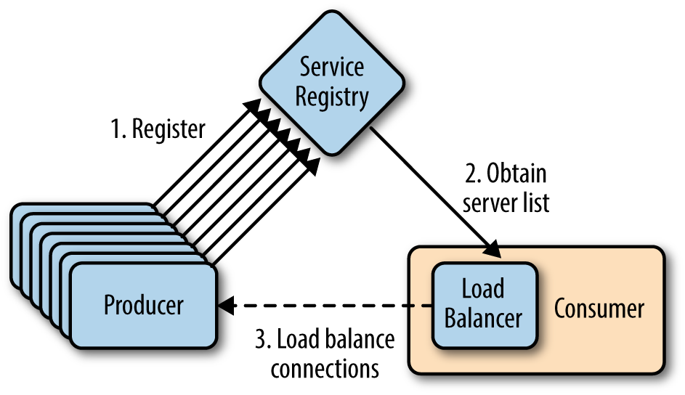
Load Balancing
Client side load balancer which gives you a lot of control over the behaviour of HTTP and TCP clients. One reason for using client-side load balancer can be performance.
API’s for client side load balancing
Ribbon, Feign - Load Balancer using Eureka, SmartStack

Slide 17
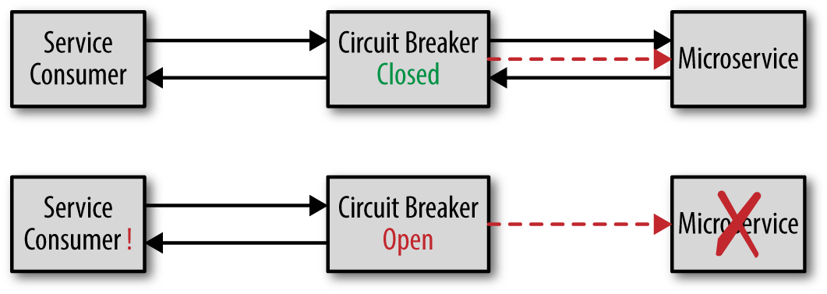
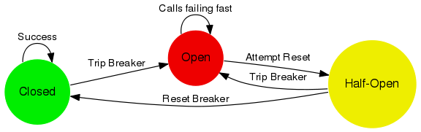
Circuit Breaker
Circuit breaker is a design pattern used in modern software development.
It is used to detect failures and encapsulates the logic of preventing a failure from constantly recurring, during maintenance, temporary external system failure or unexpected system difficulties.
API’s for Circuit Breaker
Hystrix, Turbine, Failsafe and vertx

Slide 18
Centralized configuration
we create a central config server where all configurable parameters of micro-services are written version controlled
In traditional application we created a properties files where we maintained our configurable parameters, if we changed the parameter values or added or deleted a parameter, we generally needed to restart the application container
The benefit of a central config server is that if we change a property for a micro service, it can reflect that on the fly without redeploying the micro service

Slide 19
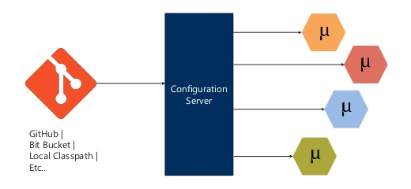
Centralized configuration Cont…
API’s for Centralized configuration
Config Server, Vault Configuration, Zookeeper Configuration, Consul Configuration

Slide 20
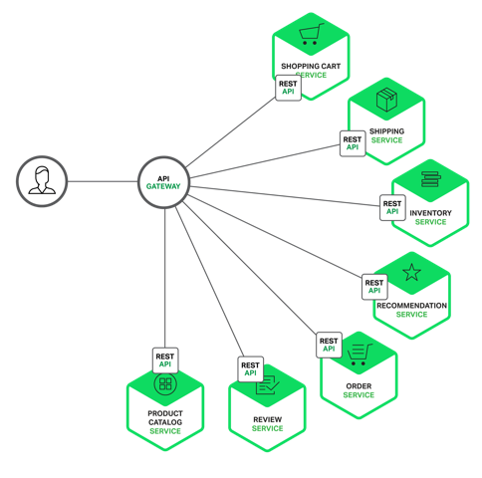
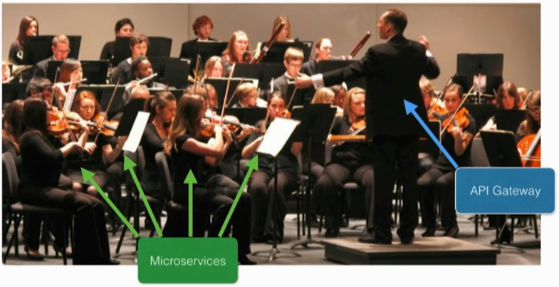
API Gateways
How do the clients of a Micro services-based application access the individual services?
Implement an API gateway that is the single entry point for all clients.
Centralized Middleware Functionality
Authentication, Security, Traffic Control, Logging

Slide 21
API Gateways
How do the clients of a Micro services-based application access the individual services?
Implement an API gateway that is the single entry point for all clients.

Slide 22
Tools or API’s
Service registration and Service discovery | Eureka, Cloud Foundry, Zookeeper, Consul
Load Balancing | Ribbon, Feign - Load Balancer using Eureka, SmartStack
Circuit Breaker | Hystrix, Turbine, Failsafe and vertx
Centralized configuration | Config Server, Vault Configuration, Zookeeper Configuration, Consul Configuration
API Gateways | Apigee, ZULL

Slide 23
Q&A

